Slide 1
Inventory Control

Slide 2
Inventory means…
All the materials, parts, expenses and in process or finished products recorded on the books by an organization and kept in its stocks, warehouses or plant for some period of time.

Slide 3
Definition of inventory control
Inventory control is the technique of maintaining the size of the inventory at some desired level keeping in view the best economic interest of an organization.

Slide 4
Type of Inventory
(1) Raw materials
(2) Work in progress
(3) Finished Goods

Slide 5
Objectives of inventory control
Protection against fluctuations in demand;
Better use of men, machines and material;
Protection against fluctuations in output;
Control of stock volume;
Control of stock distribution.

Slide 6
Models of Inventory
There are different models of inventory. The inventory models can be classified into followings:
Purchase model with instantaneous replenishment and without shortages
Purchase model with instantaneous replenishment and with shortages

Slide 7
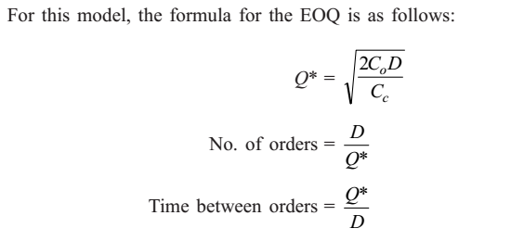
PURCHASE MODEL WITH INSTANTANEOUS REPLENISHMENT AND WITHOUT SHORTAGES
In this model of inventory, orders of equal size are placed at periodical intervals. The items against an order are replenished instantaneously and they are consumed at a constant rate. The purchase price per unit is same irrespective of order size. Let
D = annual demand in units
Co= ordering cost/order
Cc= carrying cost/unit/year
P = purchase price/unit
Q = order size

Slide 8
EXAMPLE 1
Krishna Industry needs 24,000 units/year of a bought-out component which will be used in its main product. The ordering cost is Rs.150 per order and the carrying cost per unit per year is 18% of the purchase price per unit. The purchase price per unit is Rs. 75. Find (a) Economic order quantity (b) No. of orders per year (c) Time between successive orders

Slide 9
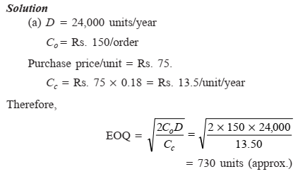
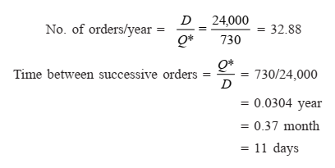

Slide 10
Example:
Alpha Industry estimates that it will sell 12,000 units of its product for the forthcoming year. The ordering cost is Rs. 100 per order and the carrying cost per unit per year is 20% of the purchase price per unit. The purchase price per unit is Rs. 50.
Find:
(a) Economic order size
(b) No. of orders per year
(c) Time between successive orders

Slide 11
PURCHASE MODEL WITH SHORTAGES
In this model, the items on order will be received instantaneously and they are consumed at a constant rate. The purchase price per unit is same irrespective of order size. If there is no stock at the time of receiving a request for the items, it is assumed that it will be satisfied at a later date with a penalty. This is called backordering. The variables which are used in this model are
D = demand/period
Cc= carrying cost/unit/period
Co= ordering cost/order
Cs= shortage cost/unit/period

Slide 12
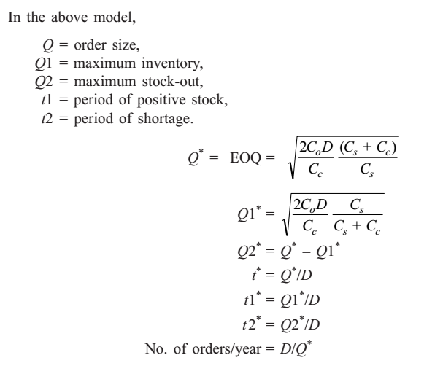

Slide 13
Example 1
The annual demand for a component is 30,000 units. The carrying cost is Rs. 2.00/unit/year, the ordering cost is Rs. 100.00/order, and the shortage cost is Rs. 12.00/unit/year. Find the optimal values of the following:
(a) Ordering quantity (b) Maximum inventory (c) Maximum shortage quantity (d) Cycle time (e) Inventory period (t1) (f) Shortage period (t2)
(g) No. of Order per year

Slide 14
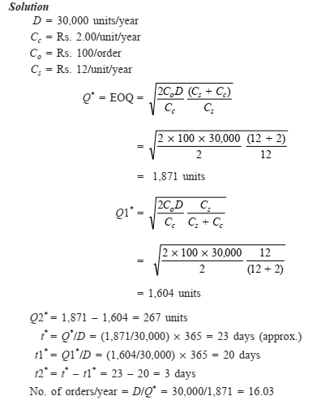

Slide 15
Example
The annual demand for an automobile component is 24,000 units. The carrying cost is Rs. 0.40/unit/year, the ordering cost is Rs. 20.00/order, and the shortage cost is Rs. 10.00/unit/year. Find the optimal values of the following:
(a) Economic order quantity
(b) Maximum inventory
(c) Maximum shortage quantity
(d) Cycle time
(e) Inventory period (t1)
(f) Shortage period (t2).

